Slide 2
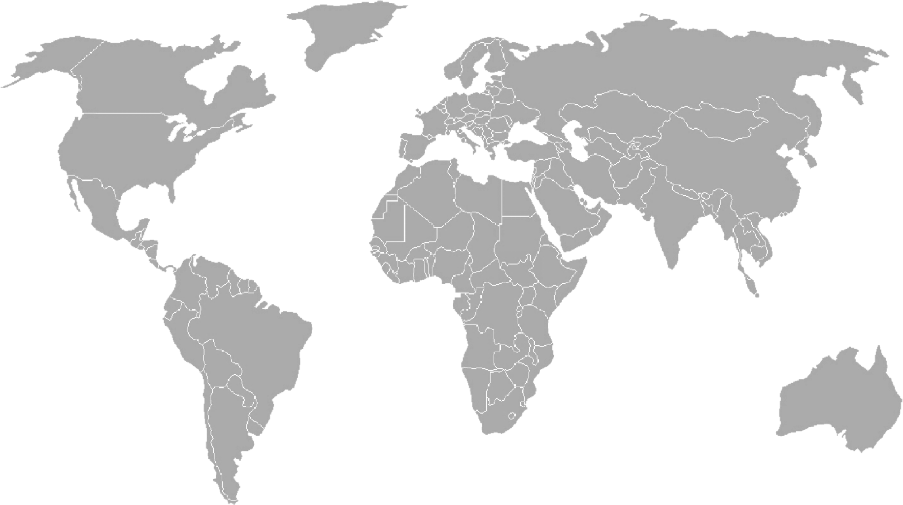
Although there were lots of people living in various places around the world in ancient times, some of the first and most significant groups of people, known as ‘civilisations’, were found in this area.
They were all located near to rivers. Why do you think that might be?

Slide 3
Warm-up Task
You are going to start a new civilisation on an undiscovered island.
What do you think you would need to make a ‘successful’ civilisation?
You can only choose 5 of these things:
Develop maths to help build houses and buildings
Spend time studying the body so that you can heal yourselves using medicine
Create tools so that you can find more materials and make things
Invent toilets and baths to keep people clean
Develop ways to farm/feed yourself
Develop writing so you can communicate with each other
Develop a system of time so that people know when to work and when to sleep
Create a form of government so everybody knows who is in charge
Create a religion so that your gods can help you
Create entertainment to keep people happy
Create a fair trading system so that you can gain other materials with others

Slide 4
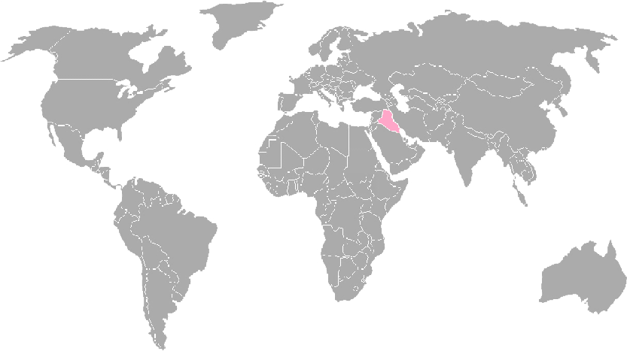
Ancient Sumer
Sumeria is thought to have some of the oldest cities in the world.
They also invented a form of writing to communicate with each other and are also thought to have invented time based around the number 60.

Slide 5
Ancient Egypt
The Ancient Egyptians invented a form of writing known as hieroglyphics. This was a set of special symbols and pictures.
They also managed to build enormous pyramids out of stone without the use of modern cranes. Medicine was also important to them.

Slide 6
Indus Valley
The civilisation found in the Indus Valley were incredibly careful when planning their towns and were some of the first to really take public health seriously.
They also had their own form of writing, but it has been very hard to translate it.

Slide 7
Shang Dynasty
The Shang Dynasty helped China grow and develop by creating a system of writing that has changed very little since its creation. They also created a strong structure in government. Their adoption of bronze for use in war also helped them take control of large parts of China.

Slide 8
Ancient Civilisations
Can we see anything that links these civilisations?
What do you notice about the time periods?
Do you think they had any impact on today’s world?
Now use the information sheet to find out some quick facts about each civilisation and to help you answer the questions.

